Slide 1
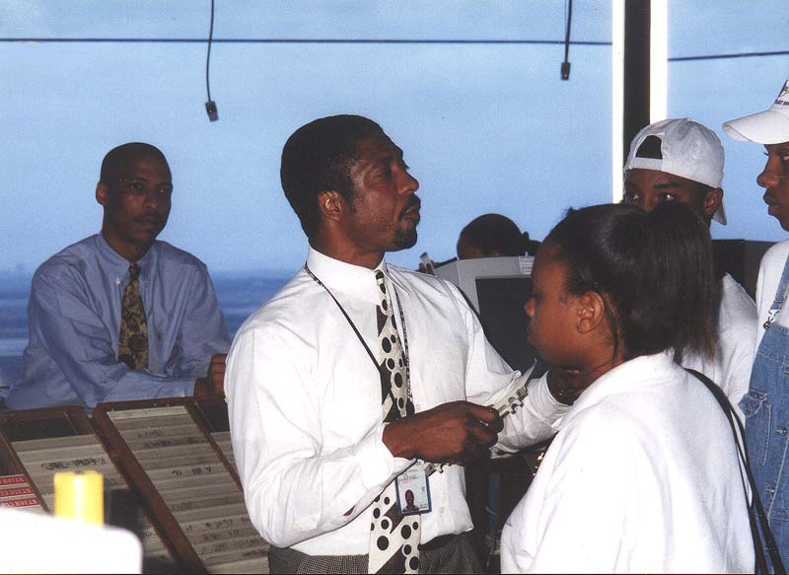
AIR TRAFFIC CONTROL TOWER
Welcome To DFW
AND TERMINAL RADAR APPROACH CONTROL (TRACON)

Slide 2
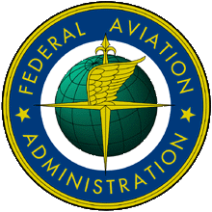
The Tower and TRACON are operated by Air Traffic Controllers, Airway Facility Technicians and support personnel of the Federal Aviation Administration under the Department of Transportation.

Slide 3
ATC System Overview
Terminals
TOWER (Controls Aircraft Taxiing, Takeoffs and Landings)
TRACON (Terminal Radar Approach and Departure Control)
Centers
ARTCC (Air Route Traffic Control Center - Enroute Control)

Slide 4
Flight Service Stations
Provide pilot weather briefings.
File and close flight plans.
Disseminate notices to airmen (NOTAMS).
Participate in search and rescue with Centers.
Airlines use their Flight Operations and the
Military uses Base Operations to perform similar
tasks.

Slide 5
AIR TRAFFIC CONTROL TOWER
The Tower controls aircraft on airport
taxiways and runways and within the Airport
Traffic Area (airspace generally out to a 5
mile radius and up to 3000 ft above the
airport).

Slide 6
The Tower’s main positions of operation include:
1. Flight Data/Clearance Delivery
2. Ground Control
3. Local Control

Slide 7
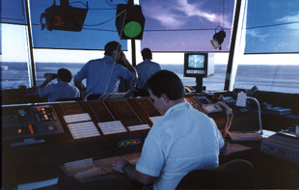
Flight Data/Clearance Delivery
The Flight Data/Clearance Delivery position processes flight plans and issues clearances to pilots. The position is responsible for making and updating a current ATIS broadcast (Automatic Terminal Information Service), for disseminating significant weather information, and for maintaining status information areas.

Slide 8
Ground Control
The Ground Controller controls aircraft on taxiways and other movement areas except active runways.

Slide 9
Local Controller
The Local Controller or “Tower” controls aircraft operations on the active runways and within the Airport Traffic Area. He/She issues landing clearances to arriving aircraft and takeoff clearances to departing aircraft.

Slide 10
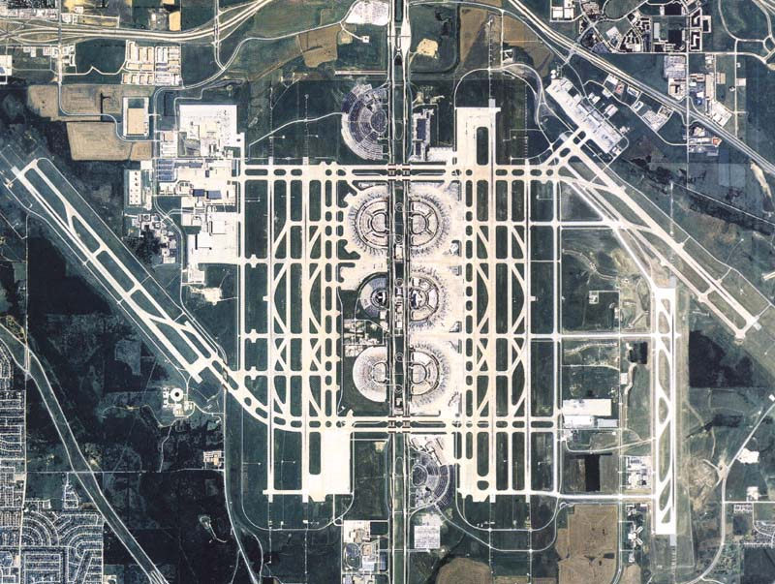
Aerial View of DFW Airport

Slide 11
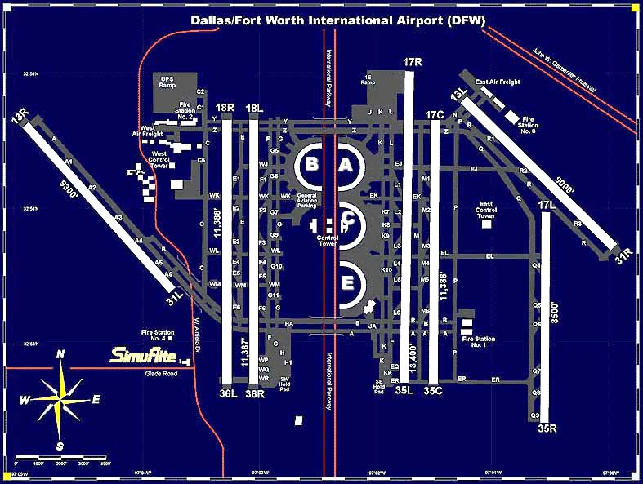
Controllers in Training
Must memorize the
Airport Layout
Graphic View

Slide 12
Arrival and
Departure Runway usage in
A South Flow
Graphic View
ARRIVALS
DEPARTURES

Slide 13
Arrival and
Departure Runway usage in
A North Flow
DEPARTURES
ARRIVALS

Slide 14
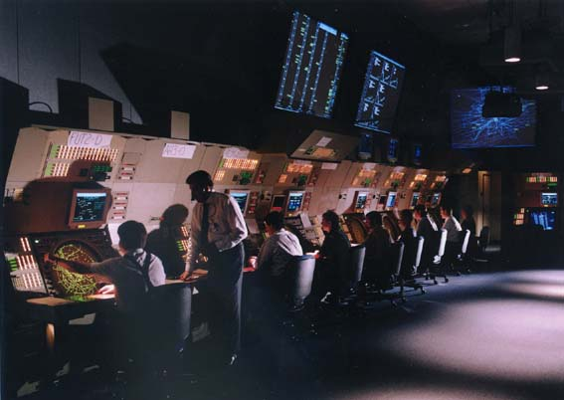
TERMINAL RADAR APPROACH CONTROL
The TRACON controls aircraft arriving and departing DFW and other airports within terminal area airspace within a 40 to 50 mile radius from DFW and up to 17,000 ft.

Slide 15
TRACON positions of operation include:
1. Arrival/Feeder Controllers
2. Departure Controllers

Slide 16
TRACON Arrival/Feeder Controllers accept control of arriving aircraft from Ft. Worth Center, space and sequence the aircraft to the active runways and transfer control of the aircraft to the Tower about 10 miles out.
TRACON Departure Controllers accept control of departing aircraft from the Tower and space and sequence the aircraft toward their initial route of flight. They then transfer control of the aircraft to radar controllers at Ft. Worth Center.

Slide 17
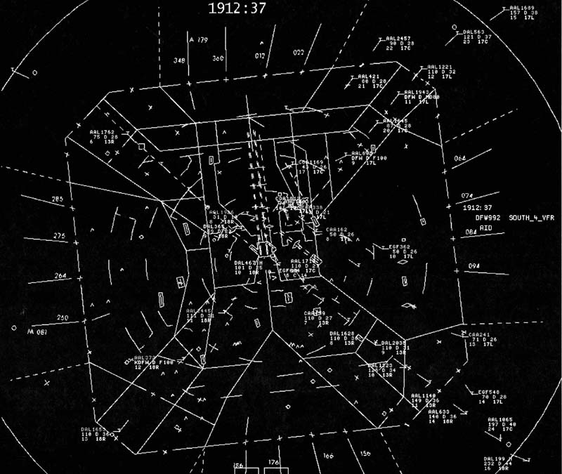
TRACON Radar Video Map Display Showing Arriving Aircraft

Slide 18
.
ARRIVAL GATES
DEPARTURE
GATES

Slide 19
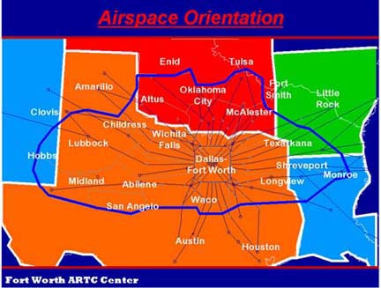
Air Route Traffic Control Centers control aircraft enroute between terminal areas.
Fort Worth Air Route Traffic Control Center’s Airspace is depicted below.

Slide 20
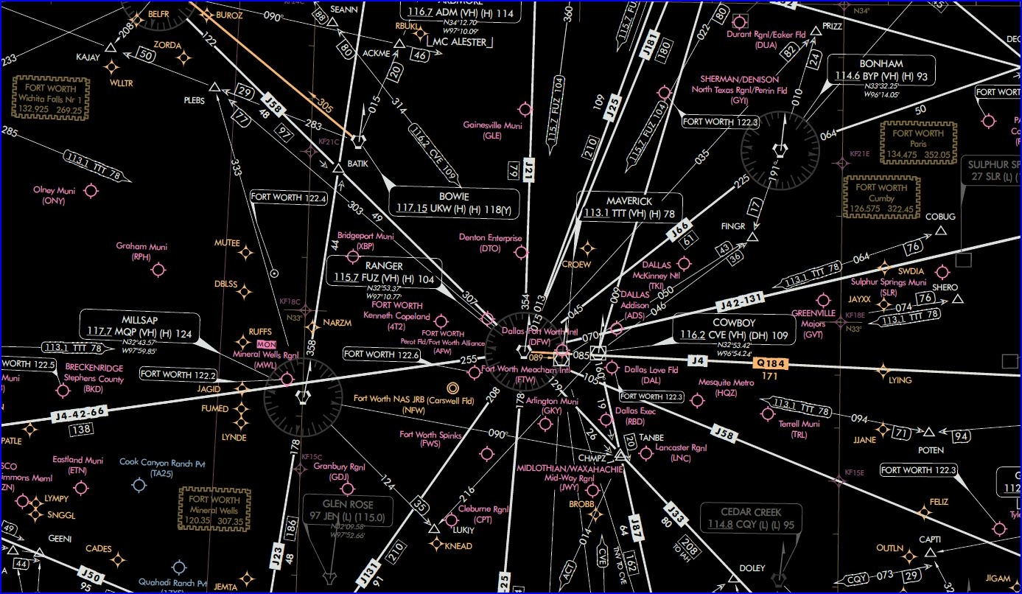
Pilots Use Aviation Charts like the Jet Airways Chart below for flight planning and navigation.

Slide 21
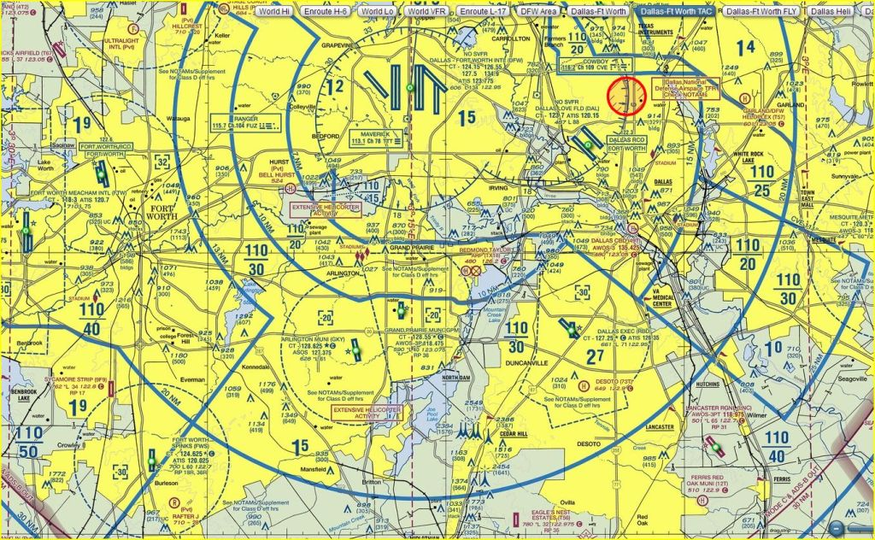
Sectional Charts like the one below contain topographical information and are used for low altitude operations.

Slide 22
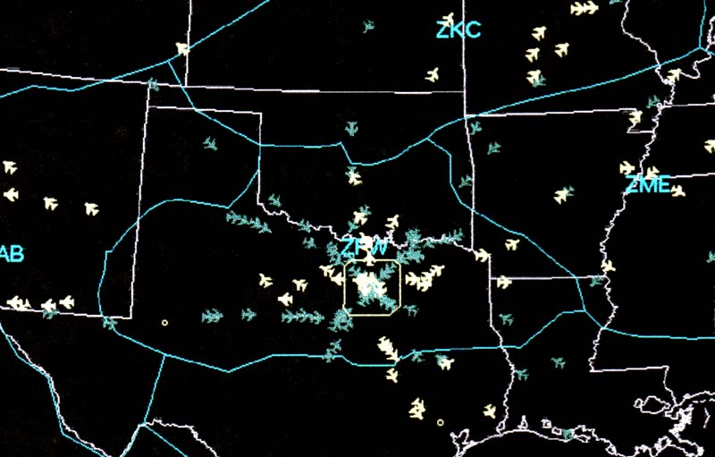
DFW & Fort Worth Center airspace showing DFW jet arrivals (blue) and departures (white). The next two slides show expanded views.

Slide 23
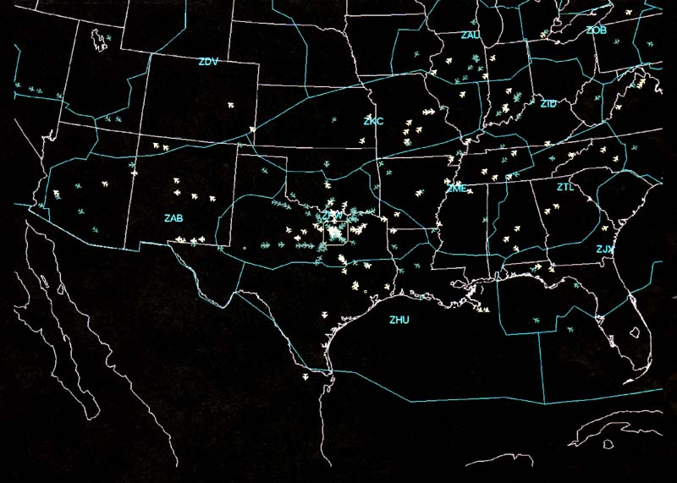

Slide 24
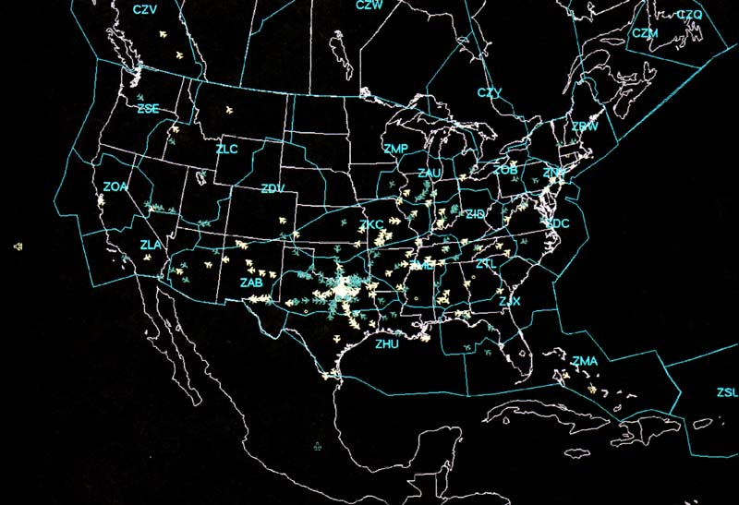
Videos 1-7

Slide 25
Some Statistics*
1.1 Million TRACON Operations/Year*
876,000 DFW Airport Operations/Year (4th* busiest airport).
TRACON Airspace/40 - 50 mile radius of DFW up to 17,000 ft.
24 TRACON Radar Positions, 8 Tower Positions, Ft. Worth Center 39 Radar Positions.
80* Controllers TRACON, 40-50* Controllers Tower, Ft. Worth Center 370* Controllers
*Numbers may vary

Slide 26
How to become a controller
Minimum of 3 years work experience
College Degree, College Training Initiative Graduate (CTI) or Military Controller experience preferred.
Under 31 years of age for initial hiring.
Pass Aptitude Test (70 or higher, 90 to be competitive)
Pass Physical (Must pass physical annually thereafter)
Pass FAA Academy Training - 17 weeks.
Pass Facility Training Program (OJT/ Can range from 6 months to 3 years depending on facility).
www.faa.gov

Slide 27
Benefits
Salary Range--Base Pay starting at $36,000 up to $174,000 per year depending on facility.
Early Retirement--25 years any age, 20 years age 50 (Age 56 mandatory for controllers and operational supervisors)
Health & Life Insurance Benefits
Familiarization Flights
5 weeks of vacation leave, 2 1/2 weeks of sick leave per year.

Slide 28
ATC Services brought to you by
17,500 Controllers
who staff
22 Centers
496 Towers
61 Automated FSS’s

